Slide 1


SAP BTP Training
Cloud Foundry Training

Slide 2

DISCLAIMER
The training content and delivery of this presentation is confidential, and cannot be recorded, or copied and distributed to any third party, without the written consent of Anubhav Trainings

Slide 3


Introduction

Slide 4

LEARNING OBJECTIVES
Introduction to BTP
Differentiate Between On-premise v/s Cloud
Explain Why SAP Cloud Platform is Used
Define What is Cloud Foundry & Give its Brief History
Discuss the Internal Architecture of Cloud Foundry
List the Installing tools – CLI, Git, Maven, STS, VS Code, Jenkins, PostgreSQL
Describe How to Setup your SAP Cloud Trial Account, Global Account, Subaccount, Org and Space Usage
--BREAK--
Build your First SAP CF App using Java
Explain the Micro-service Architecture
Define Spring, Dependency Injection
Explain pom.xml and Getting Dependencies from Maven Repository
Demonstrate How to Add Dependencies in pom.xml, and Check new Jar Files in eclipse and Using Spring Starter Project

Slide 5
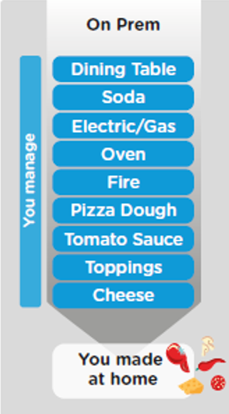
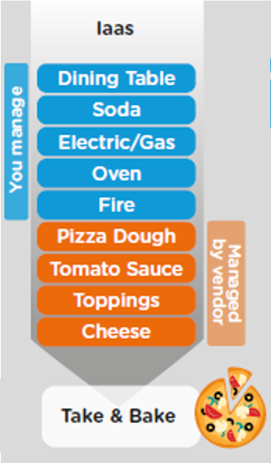
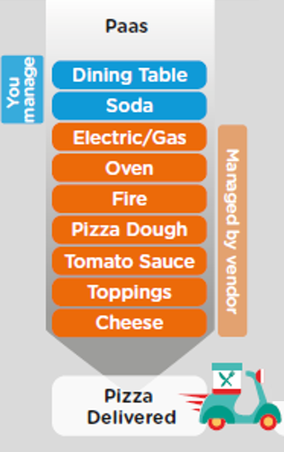
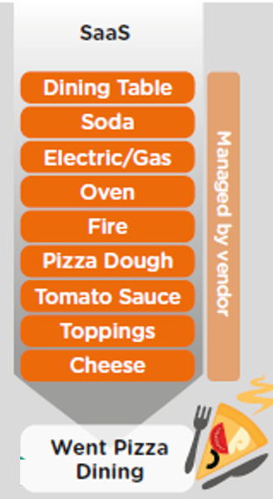
ON-PREMISE V/S CLOUD

Slide 6
TYPE OF CLOUD OFFERINGS
Application
Application As a Service
Customer Managed
Customer Managed
Customer Managed
SAP Managed
Data
Runtime
Platform as a Service
SAP/Partner Managed
Middleware
Database
OS
Virtualization
Infrastructure as a Service
SAP/Partner Managed
Servers
Storage
Networking

Slide 7




WHAT IS SAP CLOUD FOUNDRY?
Application
Application
Data
Data
Runtime
Platform as a Service
Managed by SAP implementing open source CF
Middleware
Fully ready landscape with reusable services
Scalability
Elasticity
Low TCO
Database
OS
Managed by Infrastructure
providers
Data Centers
Service Portfolio
Virtualization
Infrastructure as a Service
Servers
Storage
Networking

Slide 8





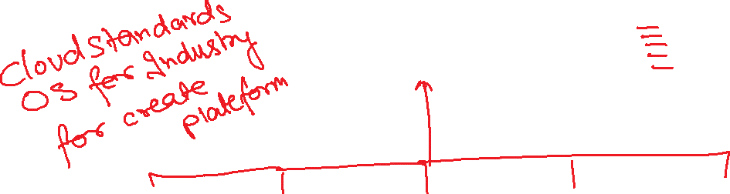







Slide 9
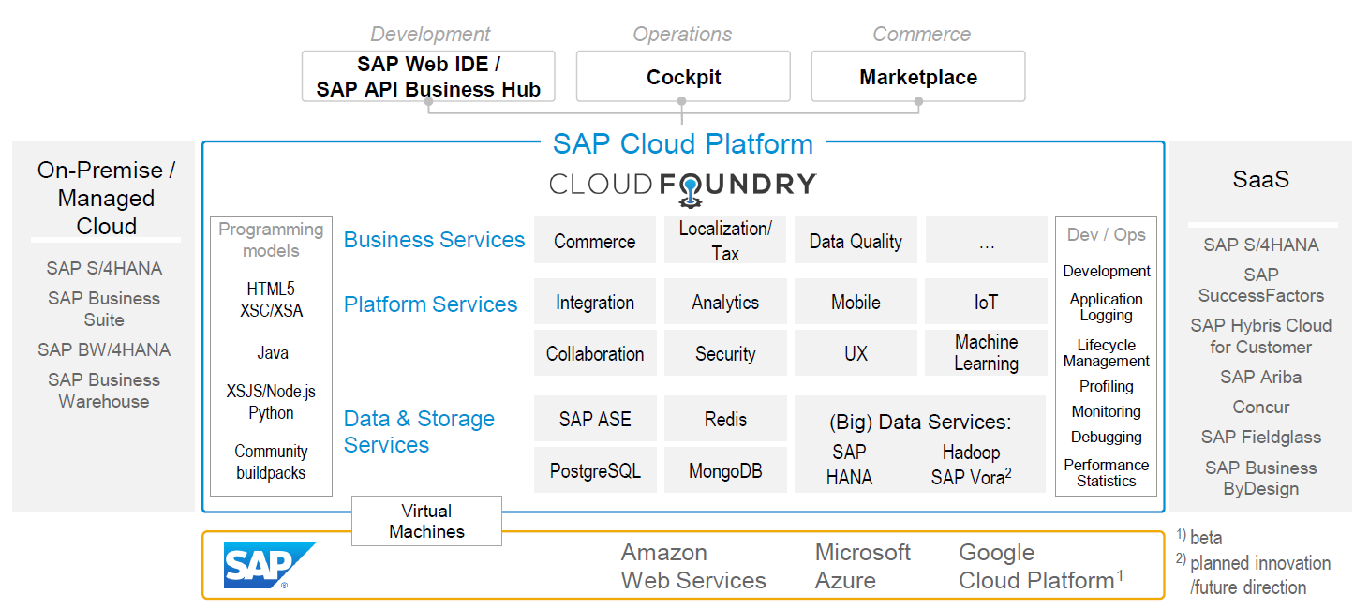
SAP CLOUD FOUNDRY ARCHITECTURE
SAP Business Application Studio

Slide 10





WHY CLOUD FOUNDRY
1
Support full development lifecycle
Build Application & Services
Development
Continuous Delivery (CD) = Code ➔ Push ➔ Test ➔ Build
Continuous Integration (CI) = Dev ➔ Quality ➔ Production
Up and Down
Deployment
Testing
Monitor and Upgrade

Slide 11

WHY CF
2
Self healing container management system
Cell
Garden = execution
Containers
A

Slide 12
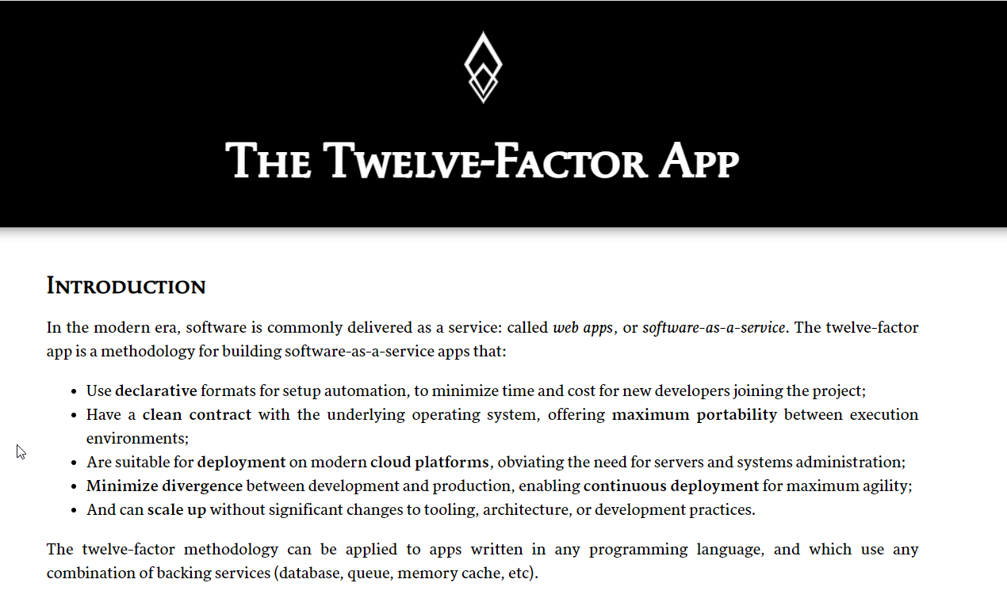

WHY CF?
3
Support 12 Factor App
It is a strategy to build software-as-a-service
https://12factor.net/
A

Slide 13
HISTORY OF CF
License: Apache 2.0
Build in Ruby, Java and Go
Open Governance Foundation
2009-2011
2012
2013
2014
2015
2019
2021
VMWare
BOSH
Open Source Tools
Seven platinum members and two gold members
40+ Members
65+ Members
Jan 2021
Pivotal Cloud foundry closes free trials
Pivotal
EMC
VMWare
General Electric

Slide 14
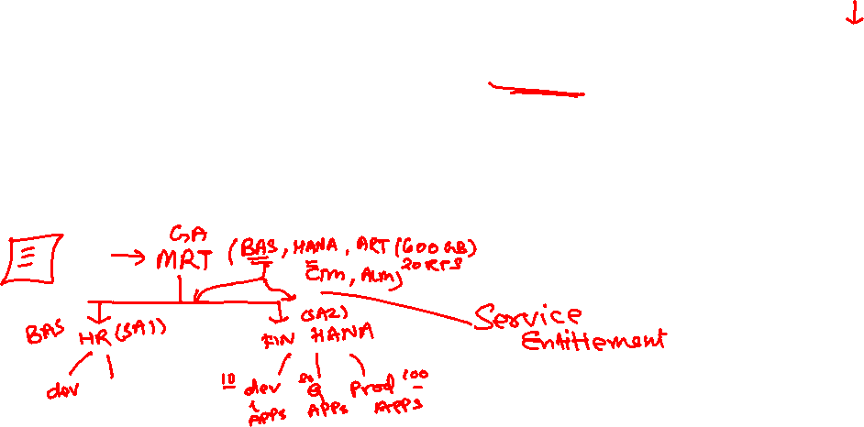
SETUP CLOUD PLATFORM ACCOUNT STRUCTURE
Backing Services
Global Account
(Representation of customer for billing purpose)
Sub Account
(per region)
Specialized service offerings
Represents LoB
Space quotas
1 *
1 *
Space
1
*
Apps

Slide 15
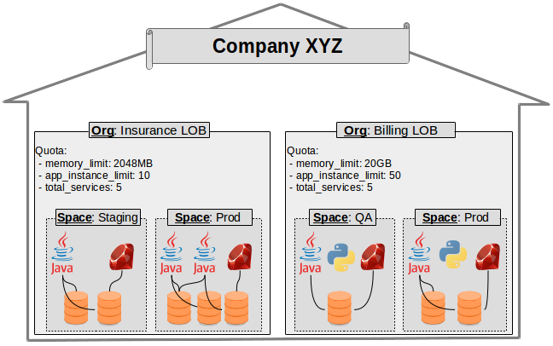
EXAMPLE – CF ORG STRUCTURE

Slide 16
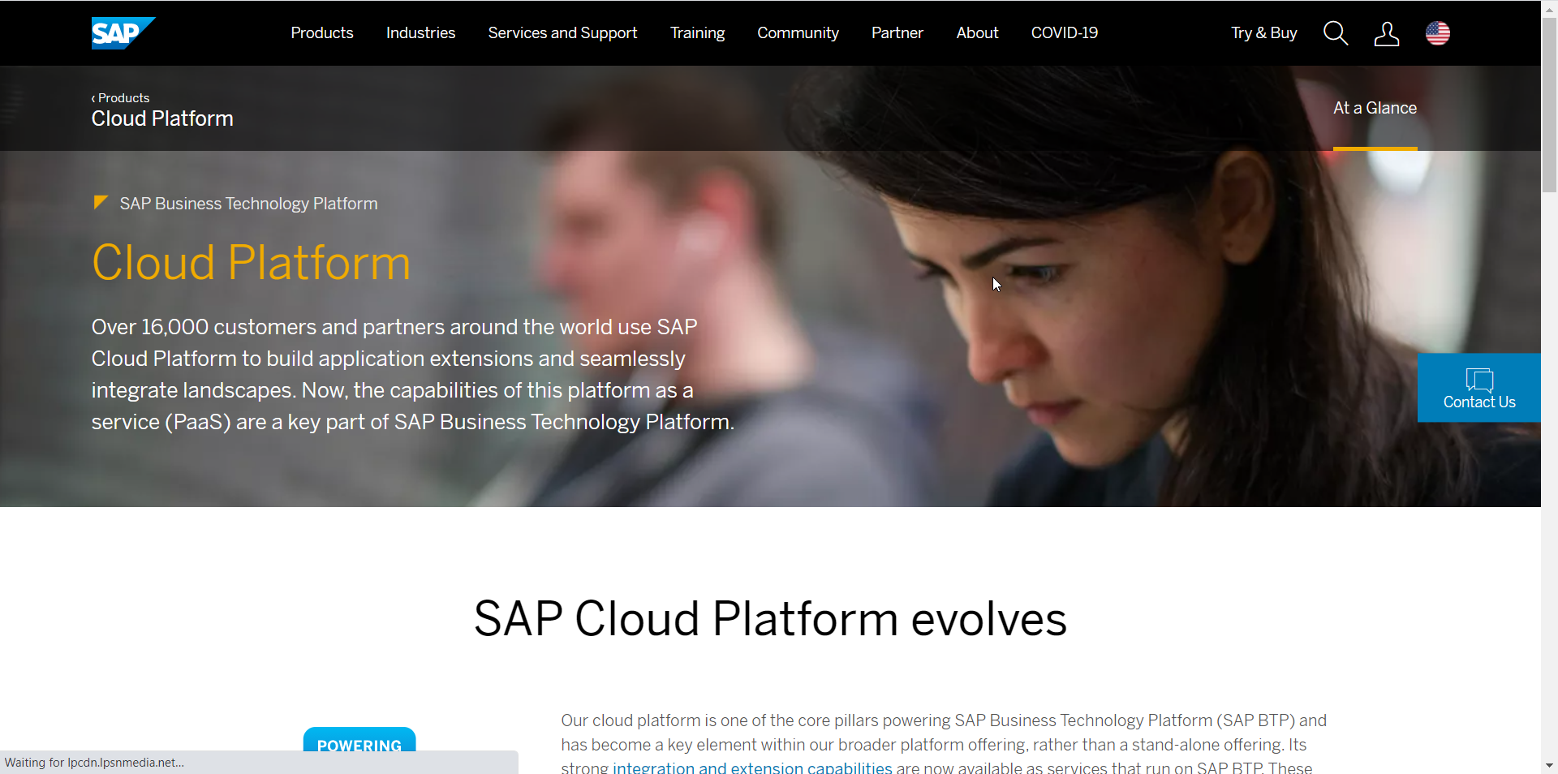
HANDS-ON – SETUP YOUR ACCOUNT
Setup your SAP Cloud Foundry Account

Slide 17
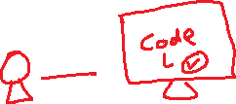
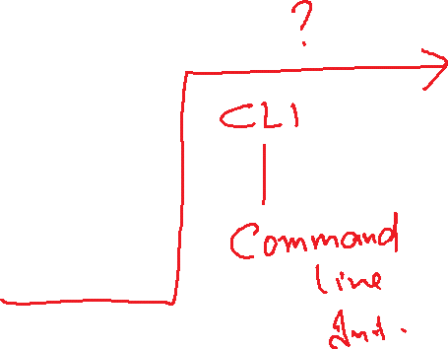
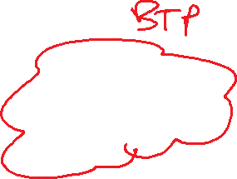


Slide 18
HANDS-ON – INSTALLING TOOLS
CF CLI
https://drive.google.com/file/d/1uKgZcNa0V77kxrJIEtMrzpdWb1HACDgu/view?usp=sharing
Git
https://git-scm.com/downloads
Maven
https://maven.apache.org/download.cgi
STS
https://spring.io/tools
VS Code
https://code.visualstudio.com/
Jenkins
https://www.jenkins.io/download/
PostgreSQL
https://www.postgresql.org/

Slide 19
HANDS-ON – CREATE AND DEPLOY YOUR FIRST APP
Download a simple go-lang application and deploy to CF.

Slide 20
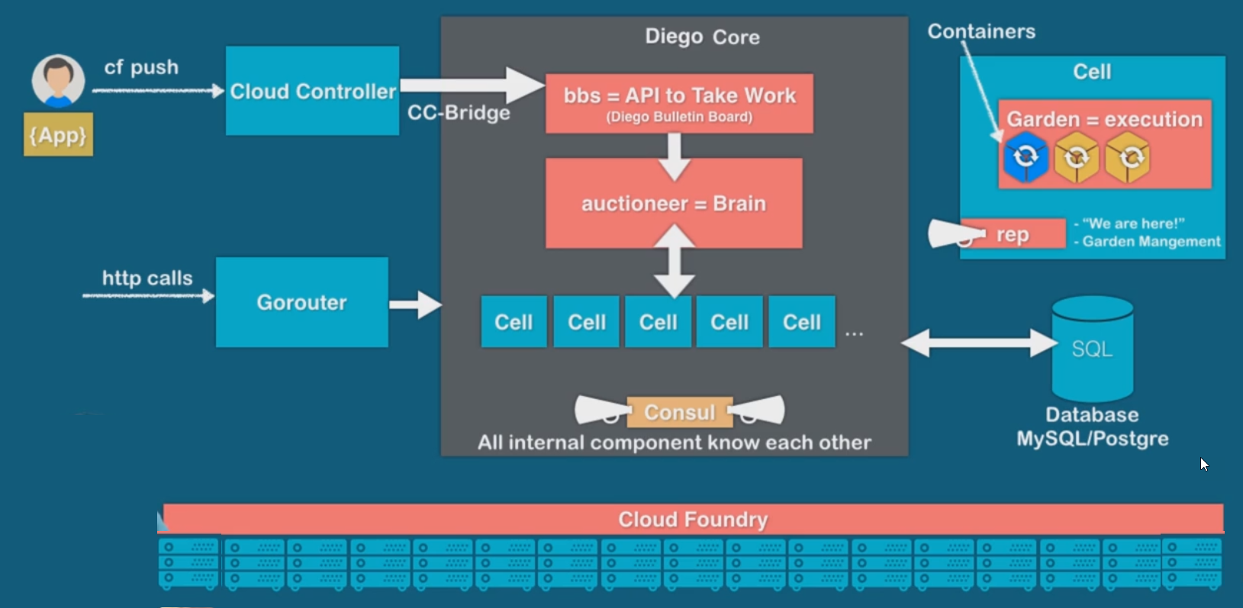
UNDER THE HOOD

Slide 21
Break

Slide 22
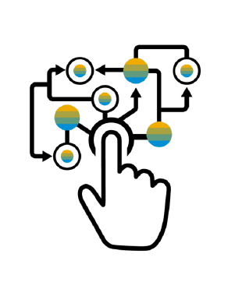
MICROSERVICE – SAP’S TRADITIONAL DEVELOPMENT AND DEPLOYMENT MODEL
Characteristics of the traditional model
SAP systems are one large logical system with a single (SQL) DB
Transactional consistency for all data is guaranteed
Big, infrequent releases with high risk
Hard to apply cloud requirements
Monolith must be built, tested, deployed, and scaled as a whole
Vertical scaling* is limited, cost is non-linear
Systems often poorly utilized (dev-test, non-peak-times)
High availability setup requires almost double the infrastructure
“Microservice architecture is an approach to developing a single application as a suite of small services, each running in its own process and communicating with lightweight mechanisms, often an HTTP REST API. These services are built around business capabilities and independently deployable by fully automated deployment machinery.”

Slide 23
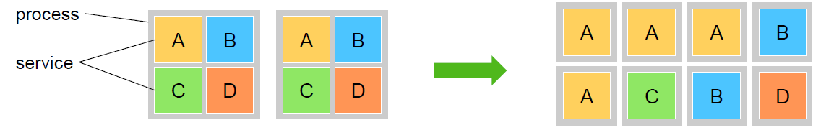
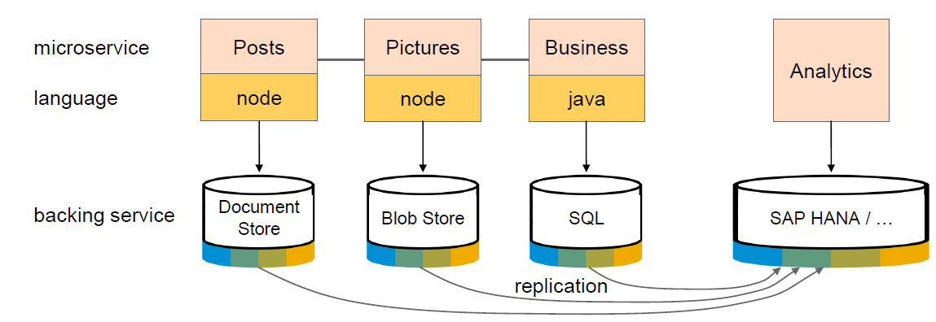
ADVANTAGES
Each microservice runs in a separate process / container.
This enables them to
Be deployed individually and frequently
(Auto)scale independently to varying loads
You can use technologies and languages that best fit the problem *
Microservices are self-contained, i.e. no shared data stores (!)
Using the right tools impacts productivity and performance

Slide 24
IN NUTSHELL
Microservices are the building blocks of cloud applications
Microservices implement one concept well (from DB to UI)
Microservices scale horizontally via processes
Microservices allow resilience against software and hardware failures
Microservices can be deployed independently, support continuous delivery
Microservices can use different technologies

Slide 25
INTRODUCTION TO SPRING, DEPENDENCY INJECTION
The Spring Framework provides a comprehensive programming and configuration model for modern Java-based enterprise applications - on any kind of deployment platform.
A key element of Spring is infrastructural support at the application level: Spring focuses on the "plumbing" of enterprise applications so that teams can focus on application-level business logic, without unnecessary ties to specific deployment environments.
The key advantage of spring framework are
Dependency Injection (Inversion of Control – IOC)
Light Weight
Loosely Coupled
Provides libraries for Runtime Environment
We can work with POJO (Pain Java Objects)
Testing (because we can change objects at runtime)

Slide 26
SPRING BOOT
Open Source Java based framework which is used to create spring projects which are production ready.
Advantage
Saves time
Provides all dependency
Developer can scaffold project types
Different options for deployment

Slide 27
HANDS-ON : SPRING BASICS
Create a Simple Airplane application which allows to command flight operations to planes by replacing wings easily.
Bean
SpringBoot Application
Airplane
Fly()
IWings
Boing
Airbus
Solution:
https://github.com/soyuztechnologies/00springboot.git
Components

Slide 28

Summarize
LET’S SUMMARISE!

Slide 29

Summarize
End of Day 1

Slide 31


We’re committed to empower you to be
#FutureReady
through powerful training solutions.
We build the workforce of the future.
250+
Corporate Clients
30,000+
Learners Trained
25000+
Learners Placed
FREE WEBINARS
Sign up for free webinars with industry experts every fortnight!
Enroll Now!
Contact us today!
https://anubhavtrainings.com

